Slide 1
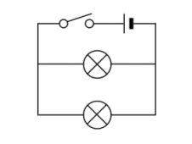

Parallel circuits
Is your work well presented?
Lesson Objectives
1. Construct and draw circuit diagrams for components connected in parallel.
2. Explain what happens to current and P.D. in a parallel circuit.
3. Determine why the current through each component in a parallel circuit varies.

Slide 2
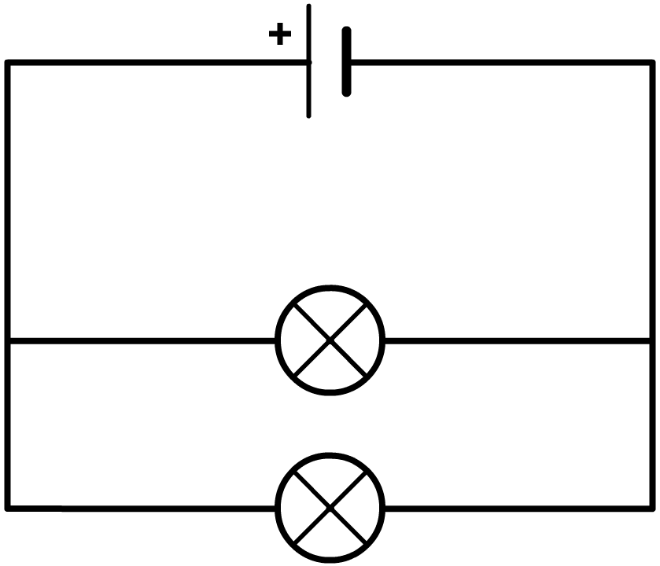

Parallel circuits.
Achieving Objective 1 - Construct and draw circuit diagrams for components connected in parallel.
A parallel circuit is one which contains a point (a junction) where the current can split (point A) or join (point B).
A
B
This means that there is more than one path around the circuit.
Review
What have we found out?
Is your work well presented?

Slide 3
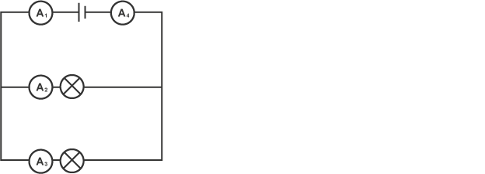
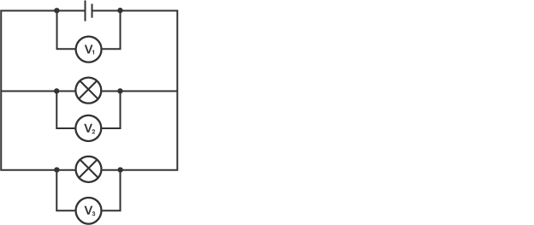
Parallel circuits.
Achieving Objective 1 - Construct and draw circuit diagrams for components connected in parallel.
Produce this circuit diagram. Draw it in your books.
https://www.youtube.com/watch?v=UM1jyQVdGD8
Review
What have we found out?
Is your work well presented?
V₂

Slide 4
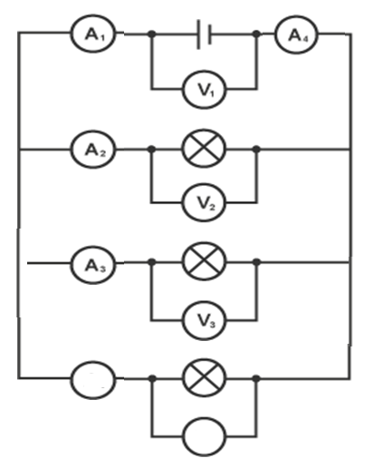
Using your results.
Achieving Objective 2 - Explain what happens to current and P.D. in a series circuit.
Using your results from the investigation explain what happened to the current and voltage when you added another bulb to the parallel circuit?
Link to these equations:
A₅
V_{total} = V₁ = V₂ = etc.
I_{total} = I₁ + I₂ + etc.
A₄
V₄
Review
What have we found out?
Is your work well presented?

Slide 5
Using your results.
Achieving Objective 2 - Explain what happens to current and P.D. in a series circuit.
When another bulb is added to the parallel circuit the current will split and decrease. However the voltage will stay the same across the circuit.
A₅
V_{total} = V₁ = V₂ = etc.
I_{total} = I₁ + I₂ + etc.
A₄
V₄
Review
What have we found out?
Is your work well presented?

Slide 6
Current in series.
Achieving Objective 3 - Determine why the current through each component in a parallel circuit varies.
A₅
Why does the current vary between the various components?
The current in a parallel circuit splits into different branches then combines again before it goes back into the supply. When the current splits, the current in each branch after the split adds up to the same as the current just before the split.
A₄
A₄
V₄
V₄
Review
What have we found out?
Is your work well presented?

Slide 7
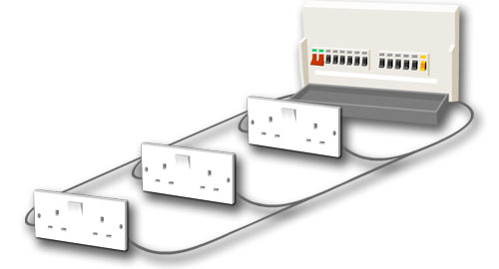
Plenary
Why are parallel circuits used in the house and not series?
Lesson Objectives
1. Construct and draw circuit diagrams for components connected in parallel.
2. Explain what happens to current and P.D. in a parallel circuit.
3. Determine why the current through each component in a parallel circuit varies.
Review
What have we found out?
Is your work well presented?

